Slide 1
Cyber Security IT-601 Lecture 03-04
Course Instructor: Ms. Sadia Perveen

Slide 2
Quick Recap – CIA Triad
Confidentiality → Only authorized users can access the data.
Integrity → Data must remain accurate and unchanged.
Availability → Systems must be accessible when needed.
Example:
ATM services
Bank account passwords
Online transactions

Slide 3
Quick Recap
Q1:
If an organization has secured its system with every possible antivirus and firewall, but an employee shares their password on social media, would you consider the organization's cyber security complete? Explain your reasoning.
Q2: Which element of the CIA Triad do you think is the most critical — Confidentiality, Integrity, or Availability? Justify your answer with a real-life example.

Slide 4
In addition to CIA, another set of protections must be implemented to secure information.
These are AAA:

Slide 5
Authentication
ensures that the individual is who she claims to be (the authentic or genuine person) and not an imposter.
A person accessing the web server that contains a user’s credit card number must prove that she is indeed who she claims to be and not a fraudulent attacker.
One way in which authentication can be performed is by the person providing a password that only she knows.

Slide 6
Authorization
Providing permission or approval to specific technology resources.
After a person has provided authentication she may have the authority to access the credit card number or enter a room that contains the web server, provided she has been given prior authorization.

Slide 7
Accounting
provides tracking of events.
This may include a record of who accessed the web server, from what location, and at what specific time.

Slide 8
Who Are the Attackers?
In the past the term hacker referred to a person who used advanced computer skills to attack computers.
Black Hat Hackers
White Hat Hackers
Gray Hat Hackers

Slide 9
Black hat hackers
those attackers who violated computer security for personal gain (such as to steal credit card numbers) or to inflict malicious damage (corrupt a hard drive).
White hat hackers
described as “ethical attackers”: with an organization’s permission they would attempt to probe a system for any weaknesses and then privately provide information back to that organization about any uncovered vulnerabilities.
Gray hat hackers
who would attempt to break into a computer system without the organization’s permission (an illegal activity) but not for their own advantage; instead, they would publically disclose the vulnerability in order to shame the organization into taking action.

Slide 10
These “hat” titles did not always accurately reflect the different motives and goals of the attackers and are not widely used in the security community.
Instead, more descriptive categories of attackers are used, including
Cybercriminals attacker
Script kiddies attacker
Brokers attacker
Insiders attacker
Cyber terrorists attacker
State-sponsored attackers

Slide 11
1- Cybercriminals
Attackers focused on financial gain (fortune, not fame).
Often part of organized gangs; coordinate via underground forums.
Common goals: steal credit cards, banking details, personal data, and sell or misuse it.
Typical methods: fraud, phishing/spam, malware, identity theft, and selling stolen data.
Targets:
Individuals & small businesses — direct financial theft (e.g., credit card fraud).
Businesses & governments — theft of research, product designs or classified info for resale.

Slide 12
2- Script kiddies
Low-skill attackers who rely on pre-made hacking tools.
Use downloaded scripts/software.
Around 40% of attacks need little or no skill.
Small sites, weak servers, home devices, user accounts.
Downtime, minor data loss.
Updates, strong passwords, firewalls.

Slide 13
3- Brokers
Sell software vulnerabilities privately rather than disclose them.
Operate in underground markets or transact with highest bidders (criminals, firms, states).
Trade often involves zero-day exploits—vulnerabilities not yet patched.
Enable attackers to develop targeted, high-impact campaigns.
Raises organizational risk by keeping flaws out of public/patching channels.

Slide 14
4- Insiders
Contractors, or partners who misuse authorized access.
Often act due to revenge, job loss, demotion.
May steal sensitive data (e.g., customer records, trade secrets).
Nearly 50% of data breaches involve insiders.
Attacks are harder to detect and often more costly than external ones.

Slide 15
5- Cyberterrorists
Attack motivated by ideology or beliefs (not money).
Goal: cause fear, disruption, or panic in society.
Targets: critical infrastructure (e.g., power grids, banks, media networks).
Attacks may be rare but high-impact and hard to predict.

Slide 16
6- State-Sponsored Attackers
Instead of using an army to march across the battlefield to strike an adversary, governments are using state-sponsored attackers for launching computer attacks against their foes.
In recent years the work of some attackers appears to have been sponsored by different governments. These attackers target foreign governments or even citizens of the government who are considered hostile or threatening.

Slide 17
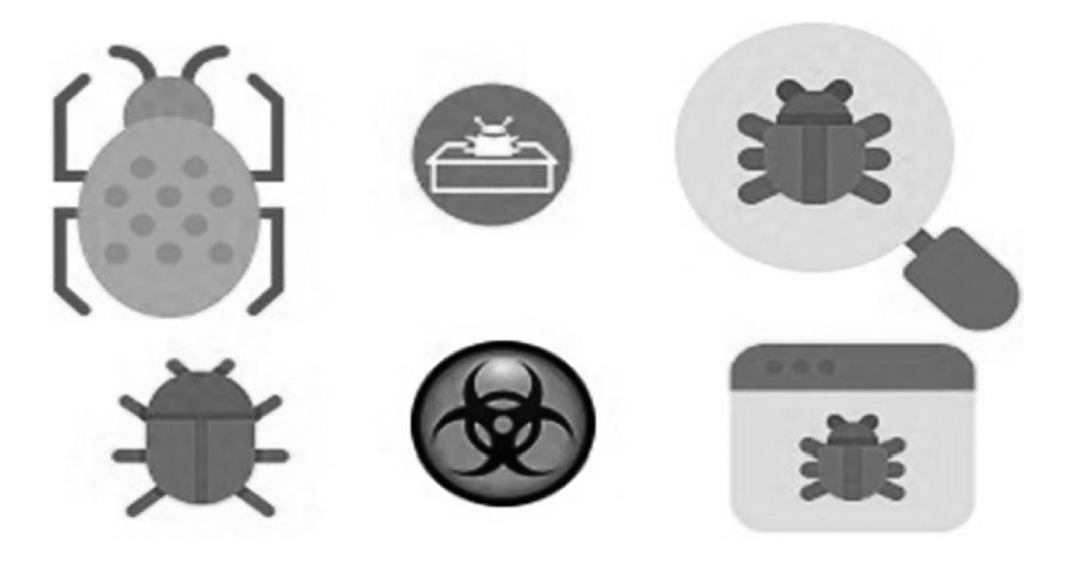
Malware attack Types

Slide 18
Malware attack
The malware is a computer software program maliciously developed to install on the computers without any consent of the users.
The main objective of such ill-conceived programs is to either establish the access to the targeted computers without any permission of the user or to install the program to create disturbance for the users.
In most of the cases, the malware programs are installed on the targeted computers to achieve different types of goals, which may include getting financial favor, knowing the business strategies, compromising the defense, damaging the governmental system, and many others.

Slide 19
Continued..
The disturbance can include pranks, data theft, data damage, service blockage, and spying on the users.
All those malicious objectives are achieved by introducing different kinds of malicious programs, which are classified into different categories in the field of information technology.
The main types of malware software programs are explained in the subsequent sections

Slide 20
Types of Malware attack
Viruses
Trojan Horse
Rootkit
Spyware

Slide 21
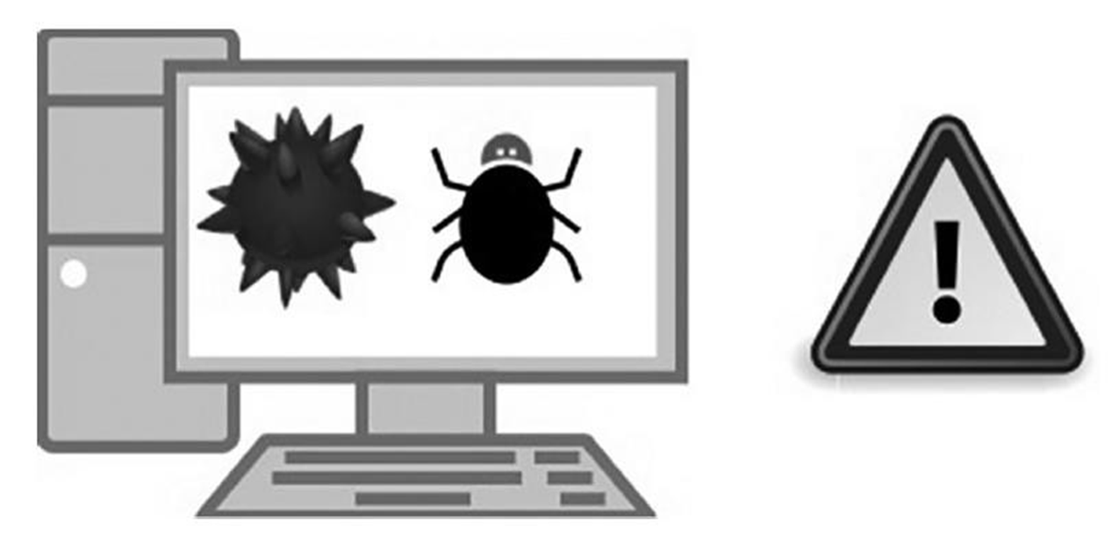
VIRUSES

Slide 22
VIRUSES
A computer virus is a malicious computer program, which is designed to alter the computer functions, slow down the computer performance, and damage the valuable files on the computer drive.
The virus programs are executable files when run on any machine by mistake, or through any trick or click, it will get activated and will start altering the computer configurations and the process, which are used for smooth operation of the computer.
The virus programs have the capability to copy into multiple files and, thus, overwhelm the computer processes and data storage.

Slide 23
VIRUSES
The main sources of virus propagation include the following:
Copying on hard drive
Data copying through flash
Email attachments
Short text messages
Scam websites
Scam social media links
Infected file downloading from Internet
Visiting infected websites

Slide 24
VIRUSES
The viruses are just programs in the form of executable files. They do not get activate without running those executable files on your computers.
The objectives of spreading a virus may include the following:
Fun and prank
Altering computer functioning
Corrupting data files on computer
Stealing credentials
Sending spamming emails from your computer
Erasing valuable data
Damaging hard drives

Slide 25
VIRUSES
In the modern world, the creation of computer virus is motivated by gaining some financial benefits on the Internet, e.g. stealing data and selling it to the third party, or using that data for malicious financial transactions.
The main symptoms of a virus-infected computer may include the following:
Frequent pop-ups and unwanted messages
Home screen/settings changed without permission
Unusual email activity (large incoming/outgoing spam)
Slow performance of the computer
Unknown programs running in background
Passwords altered, especially admin accounts
Frequent system crashes and errors
Unexpected restarts of the computer
Any other abnormal or suspicious behavior

Slide 26
VIRUSES
The solution to the menace of computer virus is to use updated antivirus software from well-known antivirus software companies.
We can save our computers from the attack of nasty viruses by taking the following measures:
Use updated antivirus software from trusted companies.
Avoid insecure and suspicious websites.
Keep your operating system and antivirus updated.
Enable firewall and configure browser security.
Avoid installing free or unsafe plugins.
Scan all external storage devices before use.
Do not open emails or attachments from unknown sources.

Slide 27
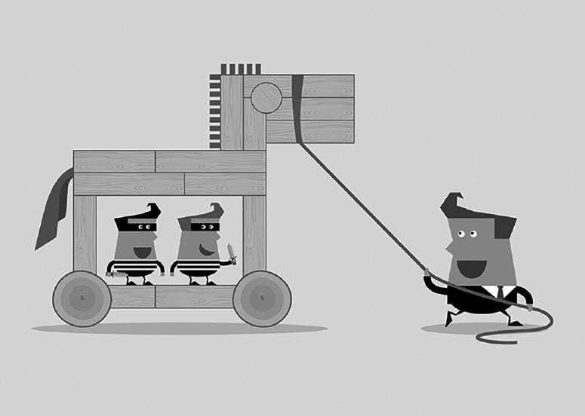
TROJAN HORSE

Slide 28
TROJAN HORSE
Trojan horse collects the information about the user behavior, credentials, and other activities on the computer silently and sends those to its command and control center from where the other malicious attacks can originate.
Hackers use Trojan to open the backdoor on your computer to access your computer and establish control on your machine.
The concept of the Trojan horse in the modern computer terminology resembles 100% with the story of Trojan horse in the Greek mythology.

Slide 29
TROJAN HORSE
A Trojan horse comes in through some social engineering tactics such as emails, disguised links, and other sources.
They would sit on the computers and start spying, making changes in credentials and doing other such malicious activities.
The main objectives of Trojan horse are to spy on the user activities and send back to its master control.
Based on the information, backdoor access on the computer is created to get control over the computer for malicious activities.
The Trojan horses cannot replicate as the virus or computer worms can do.

Slide 30
TROJAN HORSE
Generally recognized activities of a Trojan horse on an infected computer include the following:
Collecting data and sending to command and control center
Copying the files and credential information
Blocking of the data
Altering the useful data
Reducing the performance of computer
Deleting some useful data files

Slide 31
TROJAN HORSE
There are numerous types of Trojan horses used in the modern cybercriminal activities. A few very important ones are mentioned below:
Trojan Spy
Trojan Mail Finder
Trojan Proxy
Trojan Clicker
Trojan Ransom
Trojan SMS
Trojan Dropper
Trojan Fake AV
Trojan Game Theft
Trojan Backdoor
Trojan DDoS

Slide 32
How can we recognize that the computer has been infected by the Trojan horse attack?
One can diagnose by the symptoms of Trojan horse attack, which are listed below:
Performance degrades significantly.
Internet speed slows down.
Problem in Internet browsing occurs.
Many Internet browser pop-ups may appear.
Your computer security application can warn you through security pop-ups.
Computer starts working itself without your instructions.
Some crucial applications will stop working and unwanted applications will load without any control on them.
A large number of spam emails appear in your inbox.
Your contacts may receive emails that you did not send to them.
Loading of computer takes much longer.
Your data files are deleted or modified.

Slide 33
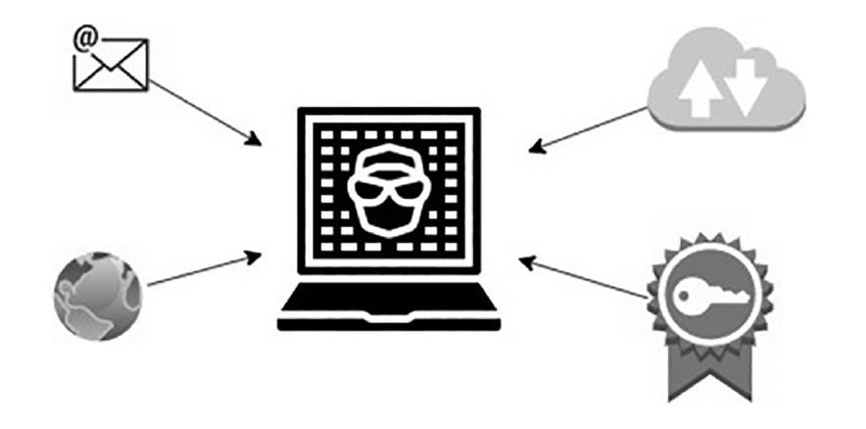
ROOTKIT

Slide 34
ROOTKIT
Rootkit is a type of malware that gets the administrator-level privileges on the OS of the computer without showing its presence on the computer.
The main feature of rootkit is that it hides from being detected easily, but maintains the control over the OS to per-form its designated tasks on the system.
The normal behavior of the OS is subverted by the rootkit malware on the system.

Slide 35
ROOTKIT
A powerful rootkit gets control on Application-Programming Interface (APIs) and establishes the full control on the system.
For instance, windows browser program sends a request to the OS API to find a certain file on the computer. The OS responds to the browser through API about that file.
The rootkit malware subverts the request sent to the OS from reaching to the desired API and responds with fake responses. Moreover, you request the OS to start the antivirus or anti-malware application to scan your computer; the request is interrupted from reaching to the OS. The rootkit interrupts the request and sends you a fake response that the program you requested for is not working at this time.

Slide 36
ROOTKIT
There are three main goals of a rootkit on a computer as mentioned below:
Running freely without any restrictions of having been caught and deleted
Hiding from the system applications and the user of the computer
Stealing personal information, passwords, and installing other malicious programs on the computer so that the compromised computer can be used for attacking the other computers on the network

Slide 37
ROOTKIT
The major ways in which the rootkits subvert the OS of the computer include the following:
By changing the API addresses of the legitimate applications’ APIs with the address of code of the rootkit. This procedure of subverting the OS functioning is known as the API hooking.
By hiding the code in the unused area of the hard disk where the APIs of OS do not see it.
Getting access to the master boot record (MBR). In certain cases, the root-kit gets access to the MBR. In that case, the rootkit code is able to subvert OS at its will because it gets the control over the loading of the applications in the memory. So, it can easily restrict certain applications to load in the memory.

Slide 38
ROOTKIT
There are numerous types of rootkits based on the objective and point of attack on the systems. A few very well-known and important rootkits are listed below:
Memory rootkits
Kernel rootkits
Bootkit rootkits
Firmware rootkits
Library rootkits
Application rootkits

Slide 39
ROOTKIT
If the computer shows the following symptoms, then you should suspect that the computer has been infected by the rootkit attack.
Modifications in the dates and time of computer
Slowing down of the computer
Unexpected system error messages
Many programs, especially computer security-related programs, fail to start
Substantial redirects on browsers
Appearance of blue screen of death

Slide 40
ROOTKIT
You can take the following steps to avert from getting rootkits control of your computer:
Always visit the legitimate and secure websites.
Do not download free and compromised products.
Open emails and their attachments from known people only.
Never open attachments in SMS and other messages.
Activate firewall on your system.
Activate intrusion prevention system (IPS).
Activate access control lists (ACLs) on the system and network.
Scan and clean flash or other data traveling devices before opening the files.
Use the latest anti-rootkit tools with Security Technology and Response (STAR).
Keep your anti-malware up to date.
Keep OS up to date.

Slide 41
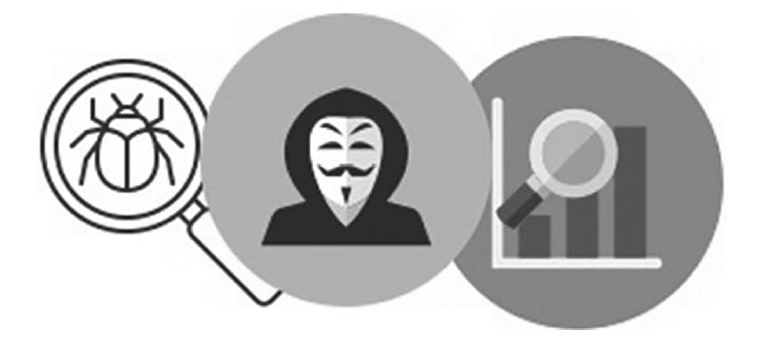
SPYWARE

Slide 42
SPYWARE
Spyware is a software code or program, which is installed on the computers without letting the user know about it.
The main objective of this program is to monitor online activities, computer using habits, and personal interests.
At the initial stages, the attack of spyware is not even noticed, but slowly and gradually, the impact of the spyware unleashes on your system as well as personally on you.

Slide 43
SPYWARE
The symptoms of a spyware attack on your computer may include the following:
System performance slows down
Any program stops working properly
Many changes in browser tools bar and plugins appear
Advertisements appear on your screen incessantly
Internet bandwidth chokes
Search engine and other preferences change

Slide 44
SPYWARE
Owing to the expanding volume of online advertisement, digital marketing, and electronic commerce, the number of spyware is also increasing in the marketplace. Newer types of spyware are being launched to spy on the behavior of the online users. The main categories of the spyware are listed below:
Modem hijacker spyware
Browser hijacker spyware
Keyboard logger spyware
Commercial spyware
Majority of adware programs broadly fall under spyware category

Slide 45
SPYWARE
In today’s Internet, where our behavior is tracked through multiple legitimate ways powered by artificial intelligence, it is very difficult to save ourselves from the impact of the spywares. But some precautions can be taken to reduce the impact of spyware on our computer.
A few important measures to reduce the impact of spyware are listed below:
Always close the advertisement pop-up windows by clicking on “X” red but-ton or ALT+F4 shortcut key.
Do not click the OK, NO, YES, or any other link on the pop-up window.
Be very careful while visiting new websites or redirected websites.

Slide 46
SPYWARE
Do not download free software tools unless you are sure or confident about the source.
Do not be lured by the tempting offers.
Do not open emails and their attachments form unknown senders.
Do not rely on free help for removing anti-spyware links; they are normally spyware themselves in many cases.
Keep your OS up to date.
Install a genuine spyware software from renowned companies.
Keep your anti-spyware up to date.
Activate firewall settings.
Increase the security level of your browser to high.

Slide 47



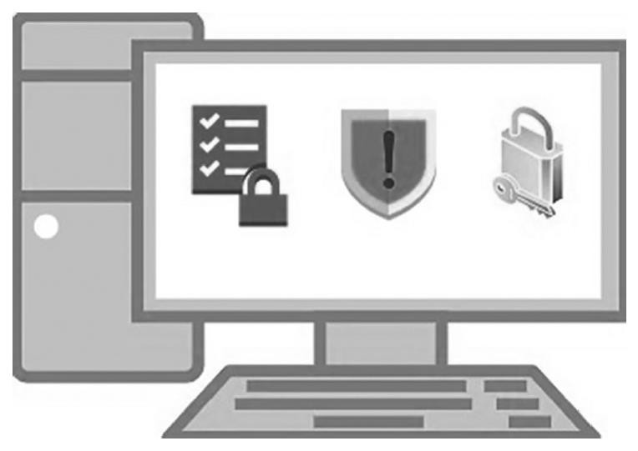
END OF LECTURE, THANKS!
QUERIES?

